Slide 1

Unit 1: INTRODUCTION

Slide 2
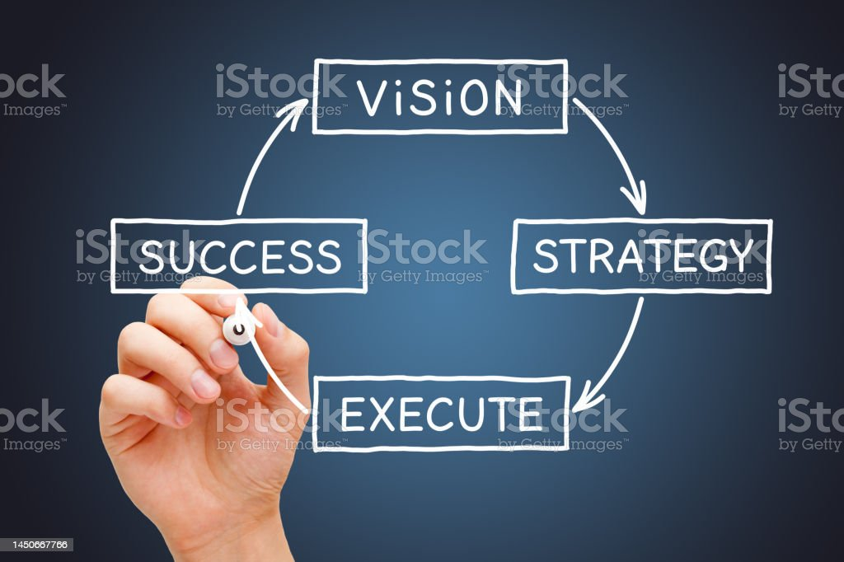
Strategy is a general plan to achieve one or more long-term or overall goals under conditions of uncertainty.
Strategy is important because the resources available to achieve goals are usually limited.
Strategy generally involves setting goals and priorities, determining actions to achieve the goals, and mobilizing resources to execute the actions.
A strategy describes how the ends (goals) will be achieved by the means (resources).
Strategy can be intended or can emerge as a pattern of activity as the organization adapts to its environment or competes.
It involves activities such as strategic planning and strategic thinking

Slide 3
Strategy is concerned with following issues;
Current and future business
Produce to be offered by the business
Target customer and market of the business
Value to be generated for competitive advantage
Resource allocation
Environmental adaptation
Organizational structure

Slide 4
Strategic Management:
Strategic management is based around an organization's clear understanding of its mission; its vision for where it wants to be in the future; and the values that will guide its actions.
Strategic management is defined as the art and science of formulating, implementing and evaluating cross-functional decisions that enables the organization to achieve its objectives.
Generally strategic management is not only related to a single specialization but covers cross-functional or overall organization.
Strategic management sets a direction for the organization and its employees.

Slide 5
Strategic management is a comprehensive area that covers almost all the functional areas of the organization.
It is an umbrella concept of management that comprises all such functional areas as marketing, finance and account, human resource and production and operation into a top level management discipline.
Strategic management relates to setting vision, mission, objectives and strategies that can be the guideline to design functional strategies in other functional areas.
It’s an important step in the management process as it helps you develop a sustainable business model. It helps you set organizational goals, perform a competitive analysis, reflect on an organization’s internal structure and evaluate current strategies.
The need for strategic management can be understood by looking toward the future of a company. Management is responsible for planning and preparing for continuous changes to navigate any undesirable situation. A clear and focused effort by upper management goes a long way in calibrating internal strengths with external deviations.

Slide 6
Characteristics of strategic management:
Conscious Process: Strategies is a product of the development conscience and intellect that we humans proudly possess and employ. Strategic management implies the usage of the brain and the heart and is not a routine ever continuing process. It requires great skill and experience to be carried out effectively and requires full applications of one's conscience.
Goal Oriented process: the process of strategic management is a goal oriented process. The process is done with the intention and goal of analyzing the various elements through SWOT analysis and other tools and to develop a plan or strategy that effectively allows the business to maneuver itself around every hurdle and make use of its strength. This process also plays the role of making all other functions of the business goal oriented as well.
Facilitates decision making: Strategic management plays an integral role in making important decisions. whenever a manger has to make a decision he has to think about the bearing of such decision on the overall strategy and the business trajectory. Thus the strategies developed acts as a guide to make efficient and accurate decision.

Slide 7
Primary Process: Strategic management is a pervasive process seen in all levels of the business has to apply in its activities is developed at the initial stage itself and only after the creation of the strategy that other processes commence by making the strategy as its basis.
Pervasive Process: Strategic management is a pervasive process seen in all levels of the business. The core strategies are formulated for the entire business by the top level management and strategies to efficiently achieve the overall goal so laid down by the top level management is developed through the various lower business units.

Slide 8
Importance of strategic management:
It guides the company to move in a specific direction. It defines organizations goal and fixes realistic objectives, which are in alignment with the company vision.
It assists the firms in becoming proactive rather than reactive, to make it analyze the actions of the competitors and take necessary steps to compete in the market, instead of becoming spectators.
It acts as a foundation for all key decision of the firm.
It attempts to prepare the organization for future challenges and play the role of pioneer in exploring opportunities and also helps in identifying ways to reach those opportunities.
It ensures the long-term survival of the firm while coping with competition and surviving the dynamic environment.
It assists in the development of core competencies and competitive advantage that helps in the business survival and growth.

Slide 9
Strategic Decision:
Strategic decision is a set of long-term decision and objectives put forth by the company which includes all their activities for a due course to achieve their dreams and goals.
Strategic decision has their own importance and play a major role as they lay the ground for the overall functioning of the organization. They describe and put in words the future of the organization by creating a track for the growth of the organization.
Strategic decisions are mostly non-repetitive. They are taken after careful evaluation and understanding of the entire organization and the market. The strategic decisions are made by the higher authorities or management.

Slide 10
Below are few of the key things that are followed in most of the strategic decisions;
Mission and vision
Working grounds
Alternatives
Employees role
Problems
Possible alternatives for solutions
Feedback

Slide 11
Importance of strategic decisions
Cope with market challenges and opportunities
Fix missions. Objectives and operation plans
Gains competitive advantages
Decide on the firm's growth and prosperity
Future direction
Strategy formulation
Resource allocation
Environmental positioning
Managerial evaluation
Strategic control

Slide 12
Strategic Decisions | Operational Decisions
Strategic decisions are long-term decisions. | Operational decisions are not frequently taken.
These are considered where The future planning is concerned. | These are medium-period based decisions.
Strategic decisions are taken in Accordance with organizational mission and vision. | These are taken in accordance with strategic and administrative decision.
These are related to overall Counter planning of all Organization. | These are related to production.
These deal with organizational Growth. | These are related to production and factory growth.

Slide 13
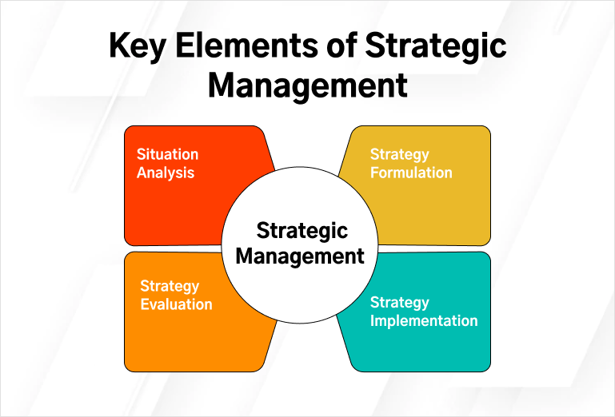
Elements of strategic Management/Process of Strategic management:
1.Strategic planning: Concerned with strategic analysis and choices for strategy formulation, it involves;
a. Environmental scanning: SWOT/SLOC analysis is done to identify external opportunities and threats and internal strength and weakness.
b. Strategy formulation: Formulates corporate level, business level and functional level strategy.

Slide 14
2.Strategic Implementation: Concerned with implementation of strategic; it involves;
a. structure design: Establishes reporting relationships. Span of control and chain of command.
b. Resource planning: Allocation of resources to various strategic business units and functions.
c. Management system: centralized vs decentralized system
3. Strategic Control: Concerned with controlling and monitoring of performance results. It involves;
a. setting the performance standards
b. measuring the actual performance
c. taking corrective measures, if there are any deviations
4. Feedback: Involves revision and or modification of strategies as per received information

Slide 15
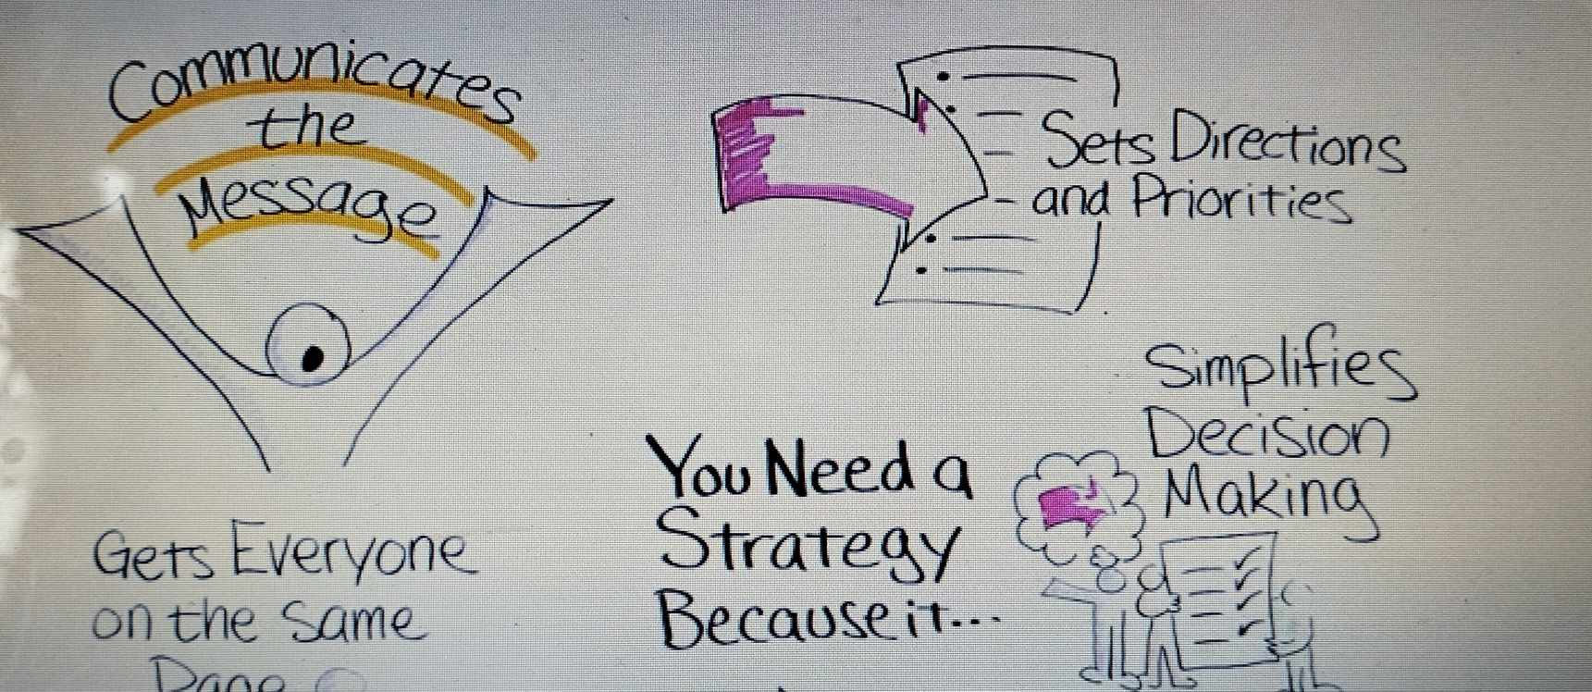
NEED FOR STRATEGY

Slide 16
Company Values:
Company values are what support the vision, shape the culture and reflect what the core values.
They are the essence of the company's identity- the principles, belief or philosophy of values.
Company values are the principles that guide an organizations actions.
Advantage of strong company values:
Company values help companies in the decision –making process. For examples, if one of your company values is to stand behind the quality of your product, any products not reaching the satisfactory standard are automatically eliminated.
Company values educate clients and potential customers about what the company is about and clarify the identity of the company. Especially, in this competitive world, having a set of specific values that speak to the public is definitely a competitive advantage.

Slide 17
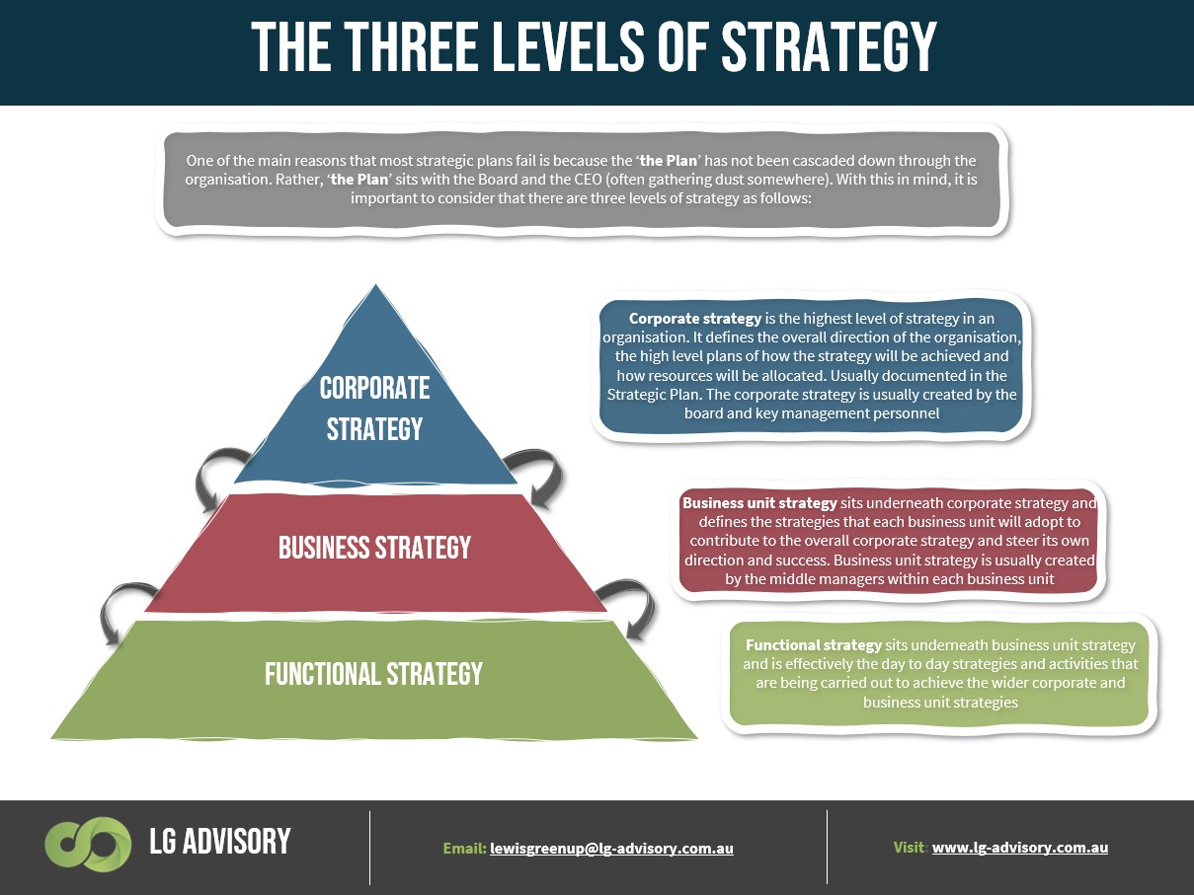
LEVEL OF STRATEGY

Slide 18
1.Corporate level:
Concerned with the decisions for the allocation of large-scale resources
It derived form the mission and vision statement
It address the question as what business are we in?
Strategies are made for five years or more
Board of directors and chief executive officers are involved in making strategy
2.Businesslevel:
At this level, decisions are made on low cost, quality and innovation
It address the question as how do we compete?
Marketing managers and production managers are involved

Slide 19
3.Operational level:
Strategies are made to bring together resources, work processes, work activities, information and people
Strategies are made for a year or less
It deal the question as how do we support business level strategy?
Strategies are made on areas of production ,marketing ,human resources, research and development

Slide 21
1.Corporate Strategy:
Corporate level strategy is the uppermost level of strategy made by top-level management which sets the overall direction of the organization. It addresses the question of what business are we in?
The corporate level strategy attempts to obtain synergy among employees, product lines, business units, and other components of the organization believing that the whole is greater than the aggregate of individuals.
The corporate strategy works based on what the organization wants to achieve overall and sets strategies following the overall goals and objectives. Corporate-level strategies are set deriving ideas from vision and mission statements.

Slide 22
Types of corporate level strategy:
Stability strategy:
The stability strategy is a strategy that tries to keep an organization’s existing activities going without making any significant changes in direction. Maintaining existing products, markets, and operations is a priority.
A stability strategy can be beneficial in the short term, but it can be harmful if used for an extended period of time.
B. Expansion/Growth Strategy
The growth strategy aims to increase sales, assets, profits, or a combination of the three. It allows businesses to take advantage of the growth curve and lower the per-unit cost of products sold, resulting in higher profitability.
Due to the increased availability of financial resources, organizational procedures, and external links, larger organizations tend to endure longer than smaller companies.

Slide 23
C. Retrenchment Strategy
A retrenchment strategy is a business approach that tries to diminish a company’s size or diversity.
Retrench strategy is adopted when the company not doing well, when an organization’s survival is threatened and it is not competing well. It involves contraction of the scope or level of business or function.
It is also called defensive strategy.
At very first, retrenchment entails selling of fixed properties to raise needed fund, cutting weaker product line or marginal business, reduce the number of employees and adaptation of expense control systems.
Turnaround Strategy:
Turnaround strategy can be referred as converting a loss making unit into a profitability one.

Slide 24
D. Combination/Mixed strategy
When an organization operates in a variety of environments, separate strategic business units and products follow a combination strategy.
In other words, a firm is said to be implementing a combination strategy if it uses stability, expansion, and retrenchment strategies in its many strategic business units at the same time.
It is primarily used to solve a variety of environmental issues.

Slide 25
2. Business Level Strategy:
Business level strategy is the which is designed to use the best use of organizational competencies to gain a long-term competitive advantage over competitors.
Business strategy deals with the question of how do we compete? It aims to how to best successfully compete with competitors so that competitive advantage will be gained.
It steers a strategic business unit (SBU) in the direction of competitive advantage. A strategic business unit is a division of an organization that has a separate district external market for goods and services from the other strategic business units.
It could be a distinct business or product such as Samsung selling smartphones, cameras, TVs, microwaves, refrigerators, etc. The corporate strategy is followed by a business-level strategy. As a result, there should be a clear link between SBU and business strategy.

Slide 26
A. Cost Leadership Strategy
Cost leadership strategy involves offering products or services at the lowest cost in the industry
This approach aims to achieve a competitive advantage by appealing to price-sensitive customers
An example of a company implementing this strategy is Walmart, which focuses on providing "Everyday Low Prices" to its customers

Slide 27

B. Differentiation Strategy
Differentiation strategy focuses on creating unique and superior products or services
By offering something distinct, companies can attract customers who are willing to pay a premium for added value
Apple is a prime example of a company employing this strategy with its emphasis on innovation, design, and user experience in its iPhone and Mac products

Slide 28

C. Focus/ Nich Strategy
- Focus strategy involves concentrating on a specific market segment or niche
- By tailoring products or services to meet the specific needs of that segment, companies can develop a competitive advantage
- Rolex is a notable example of a company following a focus strategy, targeting high-end customers with its exclusive luxury watches

Slide 29
3.Functional Level Strategy:
The functional level strategy also called operational level strategy is developed to run effectively the day-to-day activities of the organization. Most operational strategies are no longer than one year.
The functional level strategies aim to deal with the question of how do we support the business-level strategy?
A number of functions are carried out regularly to effectively run the business as different functional departmental are created – production department, HR department, marketing department, customer service department, etc. functional strategy aims to bring effectiveness in such functional areas.

Slide 30
At the functional level, resources, work pressure, information, and manpower are integrated to bring effectiveness to the business and corporate-level strategies.
Functional strategies are for short time usually less than one year. These strategies are related to capability, efficiency, customer service, product quality, and marketing.
All these functional strategists support the business level and ultimately the corporate level strategy.
Production Strategy, marketing strategy, finance strategy, human resource strategy, and research & development strategy – all are very important say parts or types of functional level strategy.

Slide 31
Changes in the Approaches to Strategic Management:
1. Financial budgeting:
During the 1950s and 1960s, the organizations were growing in size and complexity.
They faced difficulty in coordinating decisions and maintaining control
So they develop financial budgeting in the form of annual financial planning and investment appraisal, provided short-term control and aided project selection
2.Corporate planning:
During the 1950s and 1960s,firms relied on stable and expanding market condition
Organization's mostly engaged in corporate planning
Macro economic forecasts provided the foundation for the new corporate planning
The planning set goals and objectives, forecast key economic trends, established priorities for different products and business areas

Slide 32
3.Emergence of strategic management:
During the 1970s and 1980s, confidence in corporate planning firms was severely shaken.
The macro economic instability and international competition turned the business environment more turbulent
As such, firms shifted their emphasis from planning to strategy making
The focus was on positioning them in markets to maximize the profit
This shift was characterized with focus on competition

Slide 33
4.Quest for competitive advantage:
During the 1990s, the focus of strategy shifted from the industrial analysis to the sources of profit with in the firm
There sources and capabilities of the firm were regarded as the main sources and capabilities of the firm
Resource based view had emerged
5.Adapting to turbulence (hyper-competition):
First used by D’Aveni in 1994
It explains a persistent mode of competitive behavior's to force the competitors
In hyper-competition :frequency ,boldness, and aggressiveness of dynamic movement by the players accelerate to create a condition of constant change
Environments escalate toward higher and higher levels of uncertainty, dynamism, heterogeneity and hostility

Slide 34
Different Perspectives on strategy Formulation:
1.The Design Perspective
Emphasis on the relationship between strategy and structure
This relationship shows interconnectedness between strategy formulation and strategy implementation
Changes to the firm’s strategy demand changes in structure
It is important that matching each strategy with a structure enables the use of current competitive advantages as well as provides flexibility required to develop future advantages
2. Level Perspectives:
Corporate level strategy : it is the upper most level of strategy, rived from the vision and mission statement
Business level strategy: it directs a strategic business unit towards competitive advantage from the market
Functional level strategy: aim at bringing effectiveness in different functions of a business. Resources, work processes, information and man power are integrated to bring effectiveness in the business and corporate level strategies

Slide 35
3. The Positioning Strategy:
A firm’s profitability depends on the position it occupies in the industry
Positioning is dependent on five forces : threat of new entrants, power of suppliers, power of buyers, threat of product substitutes and rivalry among competitors
4.Resource Based Perspective:
It emphasizes the importance of resources and capabilities of a firm in maintaining competitive advantage
The resources and capabilities show the firm’s internal strength
The resources are the sources of sustained competitive advantage

Slide 36
Strategic Planning:
Strategic plan is a road map for the future direction of the organization. It is a long range plan for five years and more and prepared by top level management.
Strategic planning helps in knowing what we are and where we want to go so that environmental threats and opportunities can be exploited, given the strength and weakness of the organization.
A great strategic plan defines where your organization is going, how you’ll win, who must do what, and how you’ll review and adapt your strategy.
Strategic plan is a long run plan of an organization.
It determines where an organization is going over the time to come, how it is going to get there.
Strategic Planning is a process where organizations define a bold vision and create a plan with objectives and goals to reach that future.

Slide 37
Features of strategic Planning:
Process of Questioning: It answer questions like where we are and where we want to go, what we are and what we should be.
Time Horizon: It aims at long-term planning, keeping in view the present and future environmental opportunities. It helps organizations analyze their strength and weakness and adapt to the environment. Managers should be farsighted to make strategic planning meaningful.
Pervasive process: It is done for all organization, at all levels, nevertheless, it involves top executives more than middle or lower-level manager since top executives envision the future better than others.
Focus attention: It focuses organization strength and resources on important and high priority activities rather than routine and day to day activities. It reallocates resources form non-priority to priority sectors.

Slide 38
Continuous process: Strategic planning is a continuous process that enables organizations to adopt to the ever-changing, dynamic environment.
Co-ordination: It coordinates organizations internal environment with the external environment, financial resources with non-financial resources and short-term plans with long-term plans.
Optimum Utilization of resources: Strategic planning makes best use of resources to achieve maximum output. Effective allocation of resources, scientific thinking, effective organization structure, co-ordination, and integration of functional activities and effective system of control, all contribute to successful strategic planning.

Slide 39
Steps/process of strategic Planning:
1.Determine your strategic position ( Mission and Vision)
2.Prioritize your objectives.
3.Develop a strategic plan.
4.Execute and manage your plan.
5.Review and revise the plan.

Slide 40
The end

